Slide 1
Introduction to Trading Creating Value
5 conceptual charts
5 real examples
NEIL CARR
September 2020

Slide 2
The Linear Value Chain Concept
Wellhead
Customer
$
Trade & Schedule Crude and Other Feedstocks
Transfer of Crude & Feedstocks
to Refinery
Refinery Optimization
Trade & Schedule Products
Transfer of
Products from Refinery
to Terminal
Terminal
Loading
Global
Crude and Feedstock
Market
Global
Products
Market
$
$
Revenue is created at the 3 points where a physical transaction takes place with a 3rd party

Slide 3
The post ABT, Non-Linear, Value Chain Concept
internal market
– splits commercial & physical risk
PAPER
TRADERS
NEGOTIATE
(INTERNAL)
PAPER
TRADERS
NEGOTIATE
(EXTERNAL)
3
TAKE RISK
ONTO PAPER
BOOK
$
REFINERY
NEEDS
DAILY
TRADING
PLAN
PHYSICAL
TRADERS
NEGOTIATE
(EXTERNAL)
PHYSICAL
TRADERS
NEGOTIATE
(INTERNAL)
HEDGED
POSITION
ON PHYSICAL
BOOK
MARKET
$
CARGO
LOAD
TRANSIT
LOGISTICS
CARGO
DISCHARGE
TITLE
TRANSFER
$
1
$
PRODUCERS
PROGRAMS
2
LEVERAGE
OPTIONALITY
LEVERAGE
OPTIONALITY
$
$
4
5
The addition of ABT creates more points of revenue creation on the value chain

Slide 4
Creating Value
How does Asset Backed Trading create additional value ….
We can now trade in ways that we were not allowed to before
We can use hedging to “fix the value of opportunities”, thus avoiding downside exposure to volatility
We can trade in the paper markets (1:1, paper to physical) creating value from market structure
We can leverage optionality on physical trades, both at load and at discharge
How can we win ….
Our people are just as smart as any trading company’s
Our systems and processes are currently not as strong, but we will rapidly catch up
We can leverage global assets that no one else can even get close to
The challenge …..
To positively harness our people, our systems/process and our assets within a culture that embraces risk

Slide 5
Taking Risk
Imagine a very simplified example of a contango market structure and the opportunity to store 1M bbls for 3 months
We can lock in a forward exit price capturing a premium of 60c/bbl above current
Say that we can rent tankage and finance the store for 10c/bbl/mnth, giving us a three month cost of 30 c/bbl
value
So … would you take the deal ?
60
60
55
Well, yes and no !
Certainly you can make 30c/bbl by taking the 3 month view
c/Bbl
40
40
But you can also trade the “shape of the curve”, taking the 3-month trade one month at a time, rolling each month
That way instead of getting 60c/bbl you get 3x40 or 120c/bbl and a 90c/bbl premium … you’ve tripled the value
20
BUT … you’re assuming that the contango structure holds, if it changes over the 3 months, you might even lose money
time
So … which option would you take ?
How would you make the decision ?
How will you assess “Risk” ?
1
2
3
Trading managers will look at : Market fundamentals supporting the curve / risks & vulnerabilities / exit strategies / further optimization strategies

Slide 6
Hedging and Trading
1
I see a possible opportunity to move Midland crude oil from the USGC to Fawley refinery – a “geographical arbitrage”. Its for a 1000kb cargo pricing in off WTI average of 5 days after loading and pricing out average of 5 days after discharge.
The purchase price in the USGC is currently 70 $/Bbl, the sale price in Europe is currently 75$/bbl and my freight is 3 $/Bbl
….. OPEN by 2$/Bbl
But when I actually price in, the cargo it costs 72$/bbl, and when I sell, I get 72$/bbl ….. so if I did it, I LOSE 3$/Bbl
BUY
70
DERIVATIVES ACTIVITY
3
70
200
200
200
200
200
72
Step 1 : Buy 1000kb of WTI futures at 70 $/Bbl
Sell 1000kb of Brent futures at 75 $/bbl
DEAL
LOAD
WTI
D’CHARGE
Brent
Step 2 : Sell 5x 200kb of WTI futures at 72 $/Bbl
72
200
200
200
200
200
75
Step 3 : Buy 5x 200kb of Brent futures at 72 $/Bbl
4
5
SELL
75
2
PHYSICAL : Revenue – purchase – freight 72 - 72 - 3 = -3 $/Bbl
+2
$/Bbl
PAPER : WTI sale – WTI purchase 72 - 70 = +2$/Bbl
Brent sale – Brent purchase 75 - 72 = +3$/Bbl
How can we now “trade” around this physical position ? Where are the new value creation points ?

Slide 7
Creating Value - Examples
EXAMPLE 1 : Storage deal in a contango market
EXAMPLE 2 : Hedging a Midland crude cargo for delivery into Europe
EXAMPLE 3 : How does a paper desk make money
EXAMPLE 4 : Load optionality
EXAMPLE 5 : Discharge optionality

Slide 8
EXAMPLE 1
Storage deal in a contango market

Slide 9
Example 1: Attractive cargo in tank
Bought: EMS&S purchased 600KB of CPC at an attractive differential from a distressed Seller, pricing on Dated Brent 3-7 April 2017. The load window was 31/3 – 2/4. Deal was done on the 2nd March. The cargo is to be delivered in Rotterdam and subsequently stored in tank.
The FOB purchase price is Dated Brent -2.20
The estimated freight cost is 0.62 $/bbl.
Sale: The cargo will at some point in the future be sold to an affiliate or third party. The sale will happen when Differential economics improve or when value has been captured on the market structure.

Slide 10
Example 1: Attractive cargo in tank
600
KB
June
July
August
EMS&S buys CPC from third party 0/0/5
PHYSICAL
September
120
KB
120
KB
120
KB
120
KB
120
KB
Deal Date
2 March
3-April
7-April
30-April
31-May
30-June
PHYSICAL
EMS&S sell paper – ICE Brent
July
August
September
Execute futures during the physical pricing periods to offset physical
3 – 7 Apr : Sell 120 kbd of June ICE Brent as the cargo prices in
.. – 30 Apr : Asses the Hedge roll and take action to roll the hedge to next month
Buy 600 kb of June ICE Brent
Sell 600 kb of July ICE Brent
There is a trading decision to be taken everyday
When do you want to execute the roll – watch the June-July spread
How far out do you want to roll – watch the July-August+ spreads
Do you want to buy/sell all the cargo each time or split your strategy
Repeat roll until sale of cargo
At sale of cargo buy 120 kbd of September ICE Brent to close out the hedge and offset the physical
Physical and “floating” cancel out over both periods leaving the fixed prices only

Slide 11
EXAMPLE 2
Hedging a Midland crude cargo for delivery into Europe

Slide 12
Example 2: US Arb into Europe
Bought: EMS&S purchased 520KB of Midland Sweet from EMOC for export to Fawley refinery pricing on WTI from month NYMEX Calendar Month Average of load. The load window is January 18-20. Deal date 14th December.
The FOB purchase price is WTI CMA (Jan) + 4.1
The estimated freight cost is 2.35 $/bbl.
Sold: The cargo will be sold to EPCO (Fawley refinery) on a DES basis with a fixed pricing window around delivery. Estimated delivery date is 8-10 February and hence the pricing period will be 5-9 February on the average of front month ICE Brent quotations.
The sale price is ICE Brent (5-9 Feb) + 4.1 + Freight
Assumed Landed Price DTD + 1.20

Slide 13
Example 2: US Arb into Europe
EMS&S buy physical from EMOC - WTI
EMS&S buy fixed - WTI
EMS&S buy paper - ICE
520
KB
~25
KBD
~25
KBD
104
KB
104
KB
104
KB
104
KB
104
KB
5-Feb
9-Feb
Deal Date
14 Dec
2-Jan
31-Jan
104
KB
104
KB
104
KB
104
KB
~25
KBD
~25
KBD
104
KB
EMS&S sell fixed - ICE
EMS&S sell paper - WTI
EMS&S sell physical to EPCO - ICE
520
KB
Execute futures on deal date and unwind over physical pricing period “locking-in” the spread between ICE and WTI (on the deal date)
14 Dec : Sell 520KB April ICE Brent @ Fixed Price
Buy 346KB Feb WTI @ Fixed Price
Buy 174KB March WTI @ Fixed Price
2 – 22 Jan : Sell 24/25 KBD of Feb WTI
23 – 31 Jan : Sell 24/25 KBD of March WTI
5 - 9 Feb: Buy 104KBD of April ICE Brent
Physical and “floating” cancel out over both periods leaving the fixed prices only

Slide 14
EXAMPLE 3
How does a paper desk make money

Slide 15
How does a Paper Desk Make Money
Why have a consolidated Paper Desk
It’s the best way to create value
It’s the best way to limit mistakes
It’s the best way to handle “black swan” events
What are the differences between an “execution desk” and a “structure desk”
An execution desk simply takes “value on the day” actions to mitigate physical trading risk
A structure desk utilises an internal market to:
Provide value on the day risk mitigation to physical traders (as an execution desk does)
To then dynamically manage that risk and create additional value
What are their objectives
To ensure that flat price exposure is always hedged
To consolidate and trade our net structural exposure :
Hedge structural exposure aiming to minimise net position as much as possible
Maintain a long or short structural position dependent on market view

Slide 16
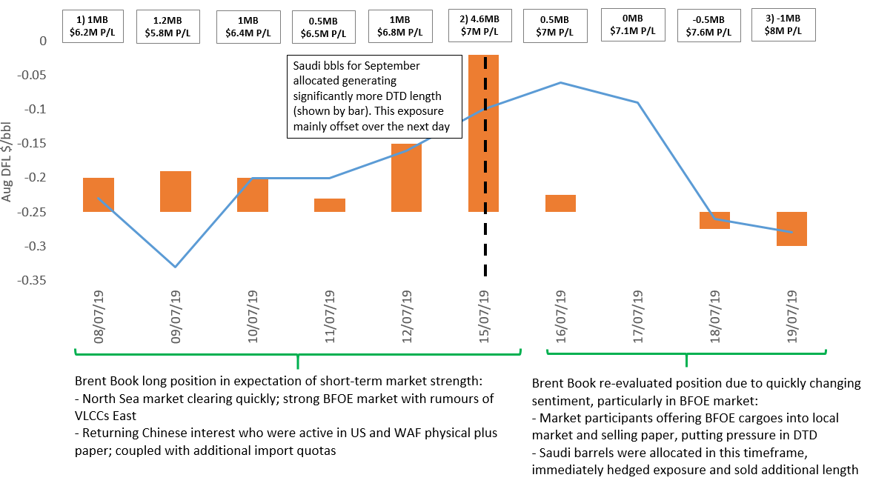
Example 1: Booking Profit on length
Market View | Position (See numbers on chart) | Outcome
Early July Brent Book was bullish on structure in short-term | Held length including Aug DFLs Saudi bbls allocated Reduced length in line with market view | Captured value as Aug DFL price appreciated, re-balanced to a more neutral position as market peaked. Book P/(L) over period (8-19 July) increased from 6.2M$ to 8M$

Slide 17
Example 2: Saudi Attacks and VAR impact
Saudi attacks caused ~$7 flat price spike, with significant intra-day volatility in markets directly after the attack
late on Sunday and Monday
Access to key paper market instruments allowed effective management of risk during the day
Consolidated position in Brent Book allowed quick assessment of exposure and actions to manage that exposure
If action had not been taken on the 16th and we had let the exposure float, Book P/(L) would have been 5.4M$ YTD
VAR Position | 13th Sept Close | 16th Sept Open | 16th Sept Close
 | $M | $M | $M
Book VAR | 1.2 | 2.5 | 0.9
Position/Actions: | Short Spreads and Structure | Covered Shorts to reduce exposure and risk | By end of day VAR had significantly reduced limiting Risk exposure
Book P/(L) YTD | 5.8 | 5.8 | 5.9

Slide 18
EXAMPLE 4
Load optionality

Slide 19
Example 4: Load Port Optionality
Qua is sold average of the Brent price, 5 days after loading (0/0/5BL) and bought on calendar month average of loading. We had a Aug 30-31cargo.
However, we anticipate loading would complete in September, since Qua Terminal was typically running a couple of days late. Therefore no hedging was required through August.
Around the 24th August it became apparent the cargo could complete in August, since production and loadings were now running on time.
At this stage there was around $1/bbl disincentive for the cargo to complete loading in August vs September as both the pricing differential and the flat price were 50c higher in August.
The traders and schedulers worked with the terminal to see if the cargo could complete in September instead, which they did.
On 25th August we got a large rally in Brent flat price which flipped the incentive to complete loading in August, even after taking the diff into account
We sold futures (catch up hedge, august to date) to lock our cargo back into August pricing on the purchase and managed to collect a profit ~$100k (level at date of catch up hedge versus month to date). Then continued selling futures, rateably, each day
On the 27th August Nov Brent dropped rapidly and the incentive flipped back for September completion of loading by approx $0.80/bbl.
Again, the traders and schedulers successfully worked with the terminal to get the cargo loading in September.
We moved our assumed purchase pricing back to September, buying back the August futures but at the significantly lower price.
Realised an additional ~$700k CM.
2
CMA aug < CMA Sept (2)
4
CMA aug > CMA Sept (1)
CMA aug > cma Sept (4)
1
AUGUST
SEPTEMBER
2
5
3
Bought at low (4)
HEDGING
4
AUGUST
SEPTEMBER
5
3
Sold at high (2)

Slide 20
EXAMPLE 5
Discharge optionality

Slide 21
Pricing Option
EMS&S purchases Basrah from SOMO on 2 different pricing bases dependent on destination of the cargo:
Typically a refinery would purchase this Basrah cargo on back to back pricing terms from EMS&S
Assumption : Cargoes destined for US are placed into the system as an alternative to LatAm barrels ie price around delivery
Therefore there is the below pricing option dependent on destination :
Destination option Purchase Price timing Refinery Price
Europe 14 days after B/L 14 days after B/L
Basrah cargo
US Month of Load Arrival at refinery
Assumptions:
Basrah cargo can go to either the US or Europe affiliate
There are requirements for Basrah in both US and European refineries
It is possible to back fill the requirement either the US or European refinery up to the date of load of the Basrah cargo
Basis risk of ASCI to WTI is managed
It is possible to charter a vessel that is flexible to go to either Europe or US at no additional cost

Slide 22
Option : Purchase 1MB Basrah cargo from SOMO loading 30th March - destination free
Option 1 : Sell 1 MB to US affiliate
If cargo goes to US then purchase physical based on month of load and sell to affiliate based on alternative Lat Am barrels that price on delivery
Paper purchase -200 KBD
Deal Date
24th Jan
Physical purchase - 45 KBD
Paper sale - 45 KBD
Physical sale to affiliate 200 KBD
1-March
30–March
Cargo loads
30 - April
4 -May
Option 2 : Sell 1 MB to European affiliate
If cargo goes to Europe then buy from SOMO and sell to affiliate 5 quotes 15 days after B/L - no hedging required as physical purchase and sale back to back
200 KBD
Deal Date
24th Jan
1-March
200 KBD
30–March
Cargo loads
16 - April
21 - April
Destination declared 14 days after load but have to advise ship of destination before this

Slide 23
Catch up hedge example
1st March : Basrah cargo originally going to Europe no hedge
Paper purchase -200 KBD
Deal Date
24th Jan
Physical purchase - 45 KBD
Sell
450kb
1-March
Paper sale - 45 KBD
Physical sale to affiliate 200 KBD
30–March
Cargo loads
30 - April
4 - May
14-March
14th March - decision taken to send cargo to US
Therefore need a “catch up hedge” ie sell the hedge that has been missed = 45 x 10 (quote days) = 450kb

Slide 24
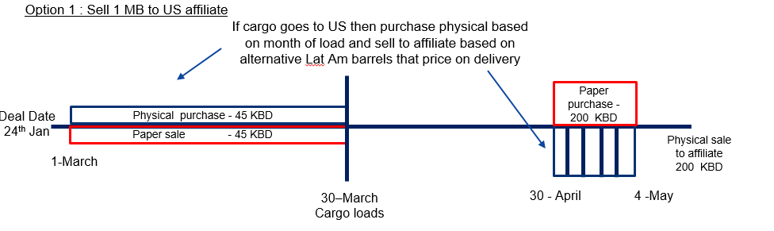
March Basrah - Hedge optionality example
1 MB Basrah cargo loading on 30th March and can go either to US or Europe, 22 WDs in a month , 45 kb pricing /day
Destination free, declaration 15 days after load
WD 1 assume that cargo goes to US therefore sell paper WTI daily as buy physical cargo on ASCI quote
Maintain hedging action for WD2, WD3 and WD4 whilst daily WTI price above rolling month average

Slide 25
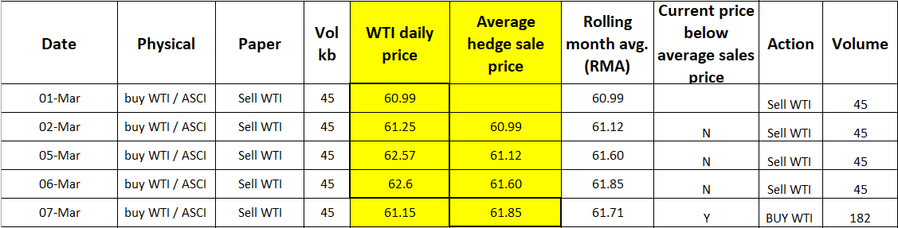
March Basrah - Hedge optionality example
On WD 5 / 7th March daily WTI price $61.15 falls below the average price of the paper sales in WD 1-4 = $61.85 then change cargo destination to Europe
As no hedging action is required if cargo goes to Europe then take off WTI paper position ie buy back hedge at $61.15
Hedge close generates P/(L) eg sold $61.85 buy $61.15 on 182kb = $0.128M profit

Slide 26
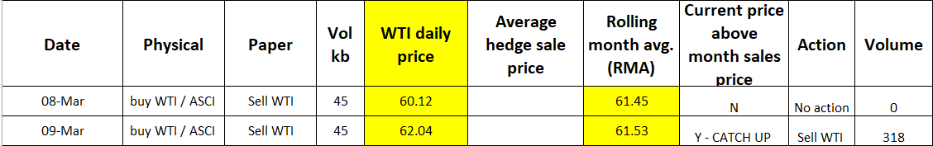
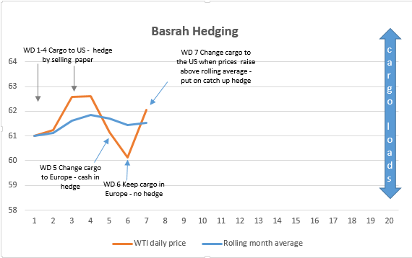
March Basrah - Hedge optionality example
Start to compare current hedge price with the Rolling Month Average ie price we should have sold the hedge at if the cargo was going to the US
On WD 6 / 8th March the WTI price continues to fall cargo destination maintains in Europe
On WD 7 / 9th March the WTI price $62.04 rises above the RMA $61.53 therefore if we change the destination of the cargo to the US we will hedge cargo again and sell a “catch up” hedge to cover the prior trade days. Therefore sell 7 x 45.4 = 318 kb at the todays price of $62.04.
Catch up hedge generates P/(L) eg month average price is $61.53, catch up hedge sales price is $62.04 ie P/(L) = 0.51 x 318 = $0.162 M (if cargoes goes to US)

Slide 27
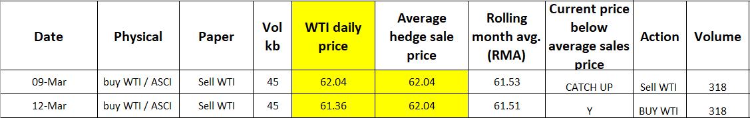
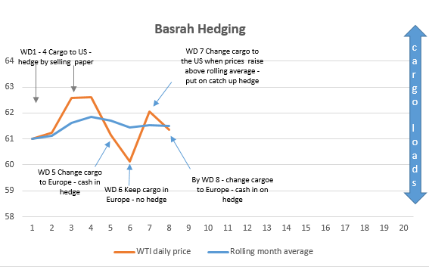
March Basrah - Hedge optionality example
On WD 8 / 12th March the WTI daily price falls to $61.36 and below the price that we have sold paper the previous day $62.04 therefore the cargo destination would flip to Europe.
The paper hedge will be closed out, buy back 318kb on WTI P/(L) = ($62.04 - $ 61.36) x 318kb = $0.216 M
Total paper P/(L) on WD 8 = $0.128 M + $0.216 M = $0.344M

Slide 28
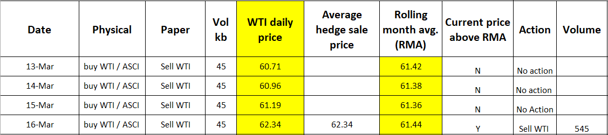
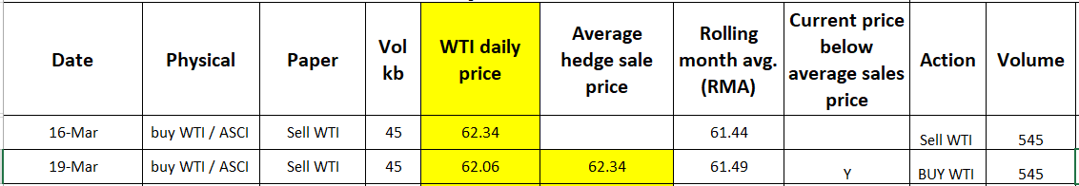
March Basrah - Hedge optionality example
WD 9 -11 / 13 – 15 Mar the WTI daily price remains below the RMA ie loss if sell hedge so keep cargo in Europe
WD 12 / 16th March current price $62.34 above RMA $61.44 so re assign cargo to US and put on catch up hedge 12 x 45.4 = 545 kb
Potential paper gain P/(L) = $ 0.90 ($62.34 - $61.44 ) x 545 kb = $0.491 M (if cargo goes to US)
WD 13 / 19 Mar the WTI daily price falls below the average sales price ie redirect cargo Europe and buy WTI / take off hedge
Paper hedge P/(L) = $ 0.28 ($62.34 - $62.06 ) x 545 kb = $0.153 M
Total paper P/(L) on WD 8 = $0.128 M + $0.216 M + $0.153 = $0.497M

Slide 29
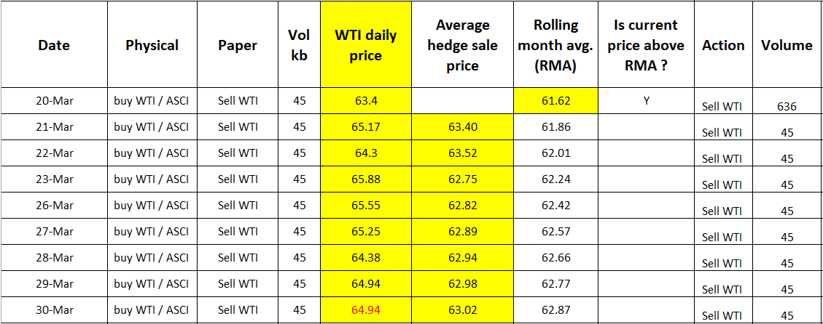
March Basrah - Hedge optionality example
WD 14 / 20 Mar the WTI daily price rises above the RMA sales price ie redirect cargo to US , sell catch up hedge
Paper P/(L) = $1.78 ($63.40 - $61.62) x 636 (14 x 45.4) = $1.1M (if cargo goes to the US)
As prices continue to rise then keep cargo into US and capture the P/(L) on the hedge
Total paper P/(L) on WD 22 = $0.128 M + $0.216 M + $0.153 + $ 1.1 = $1.6 M ☺

Slide 30
Backup

